Slide 1
FiiO Q4-2017….Q1-2018
Examples of Marketing Activities

Slide 2
Press Information
#1
FiiO F Series – FiiO on the earphone market
#2
FiiO BTR1 - mobile bluetooth DAC
#3
FiiO Q1 2nd Generation Hi-Res DAC/AMP
#4
FiiO Q5 – Top Hi-FI Bluetooth DAC from FiiO
(not released yet)

Slide 3
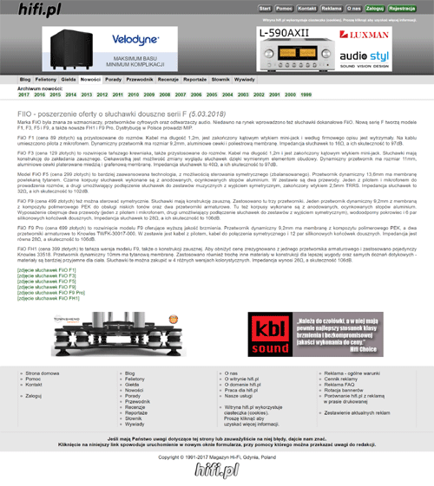
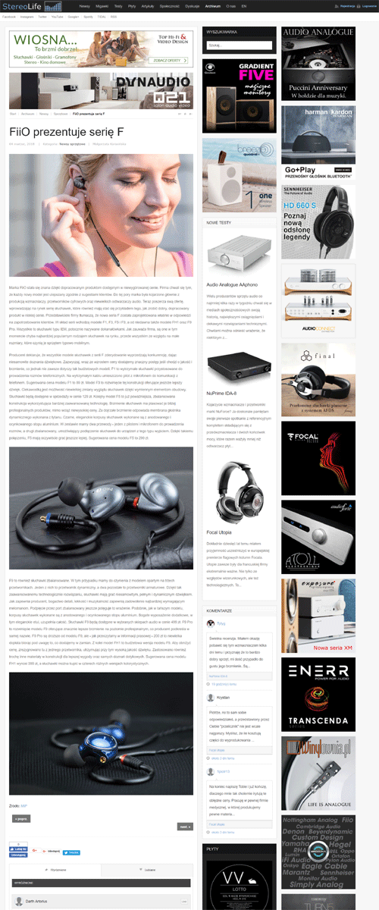
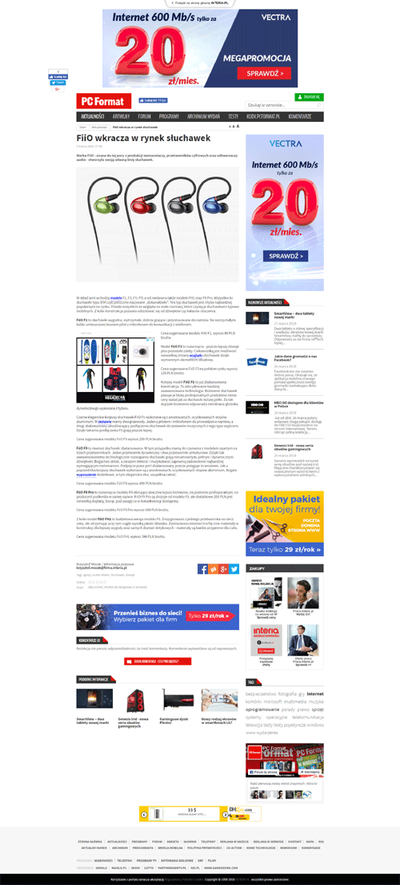
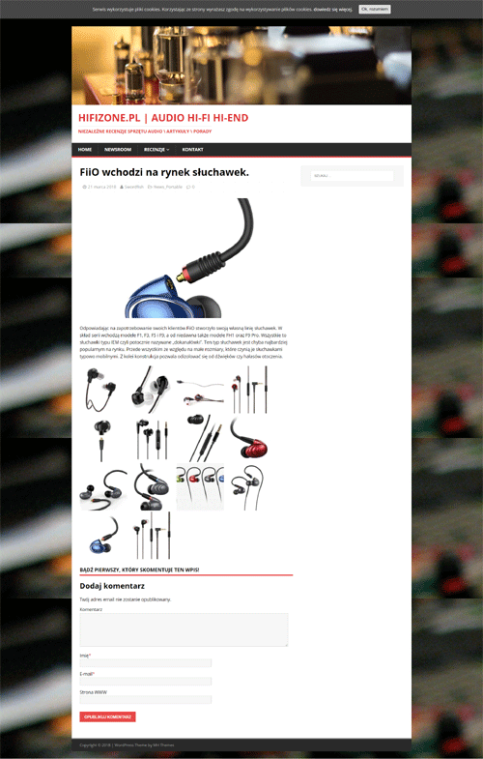
Example of PR publication

Slide 4
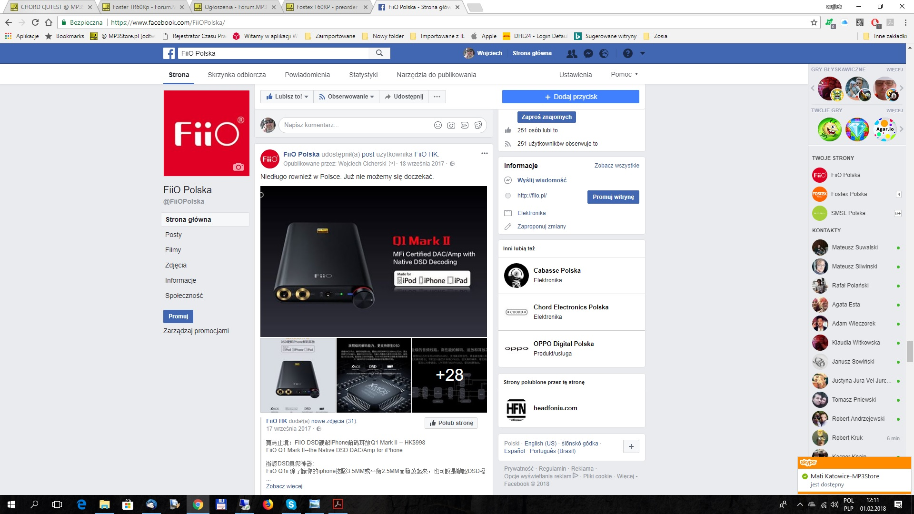
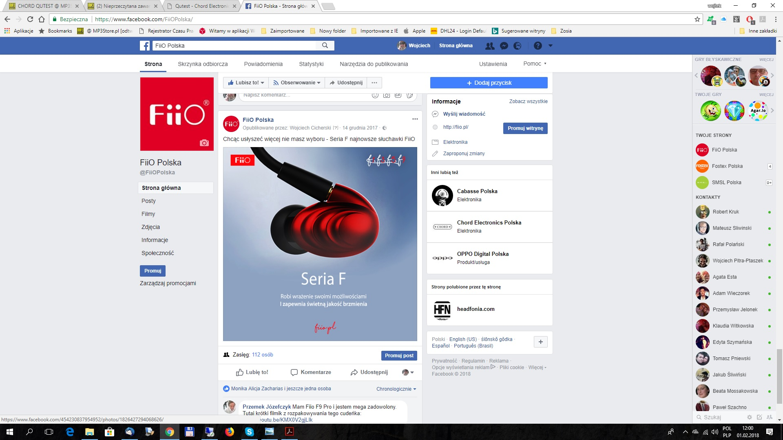
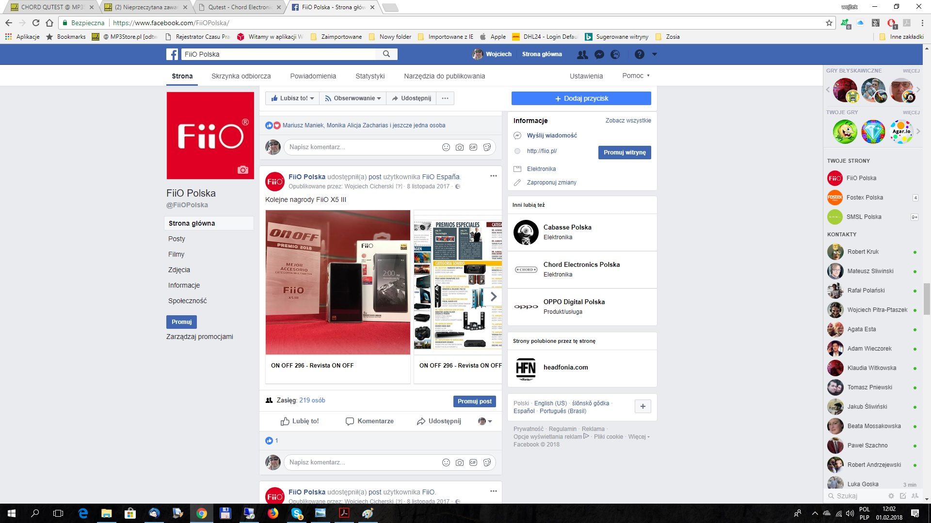
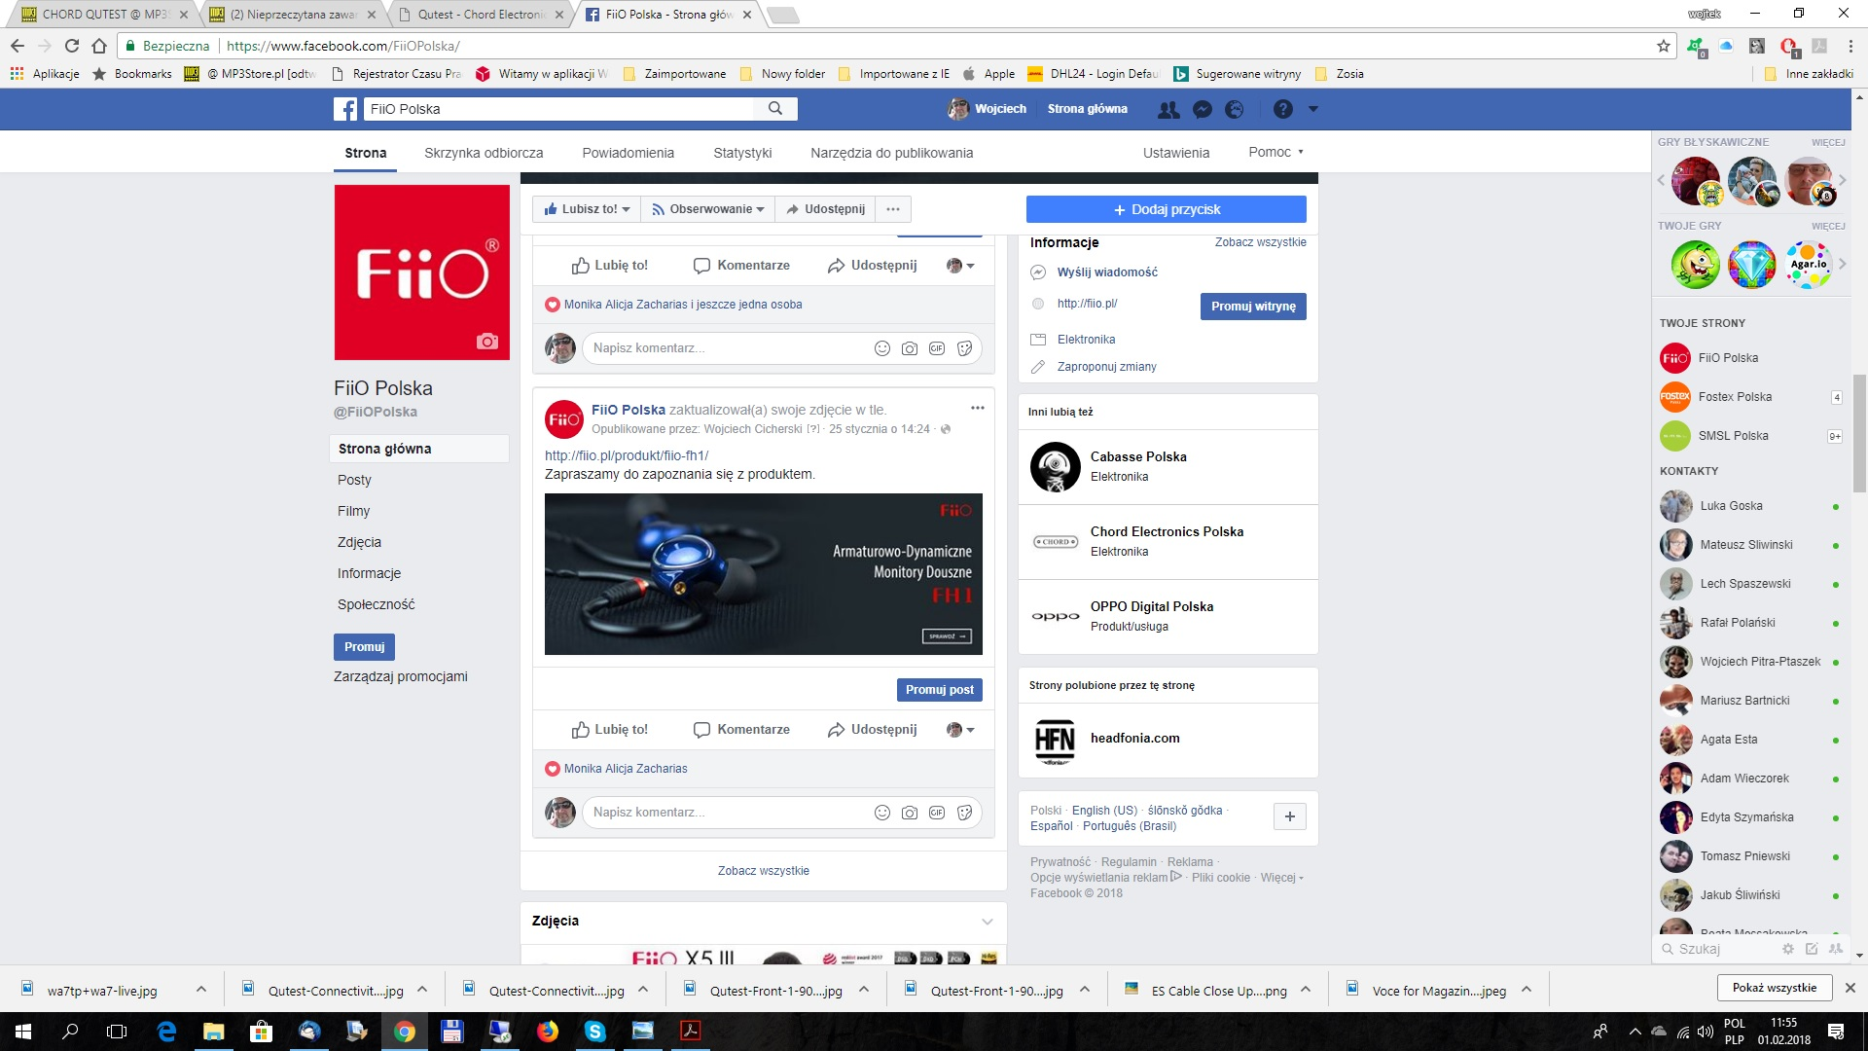
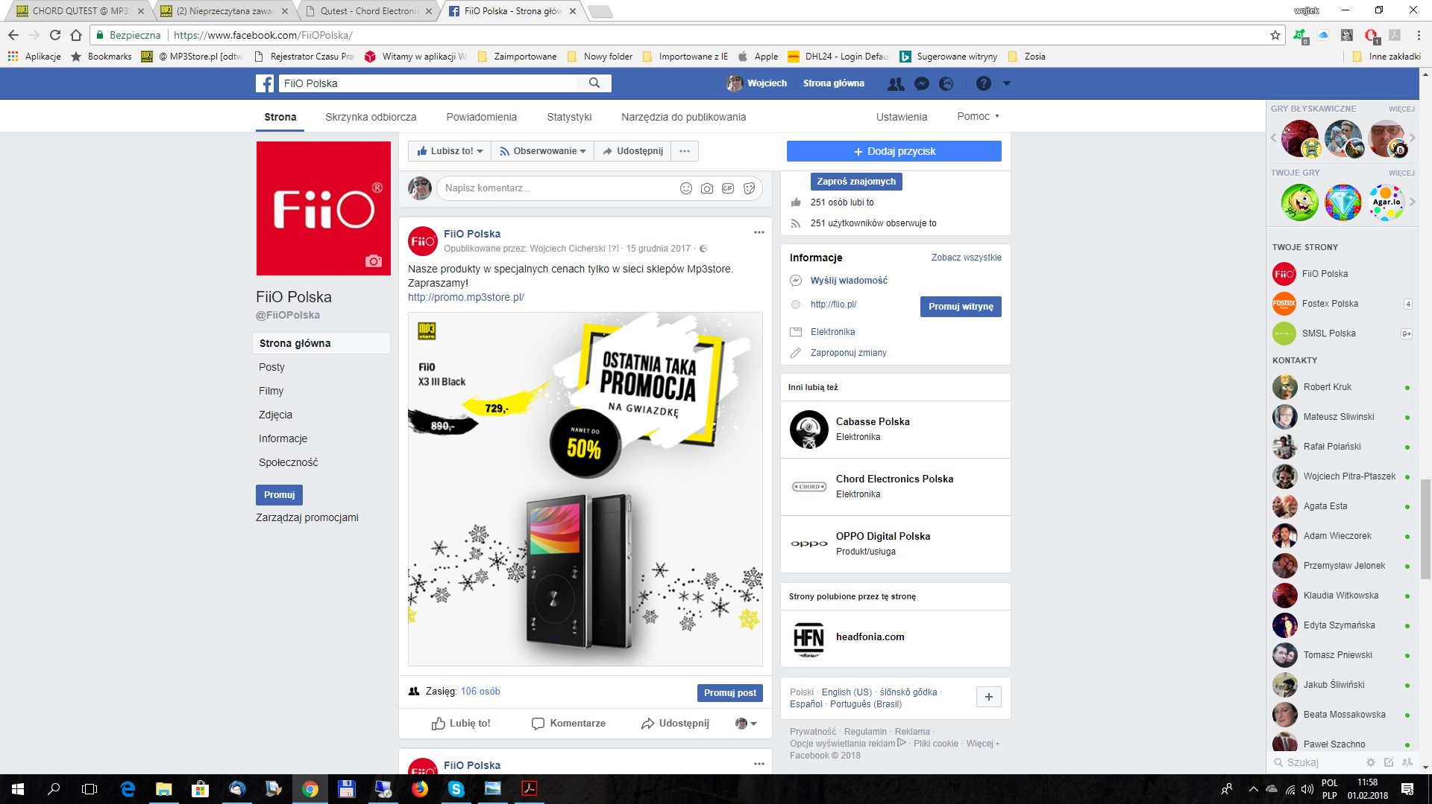
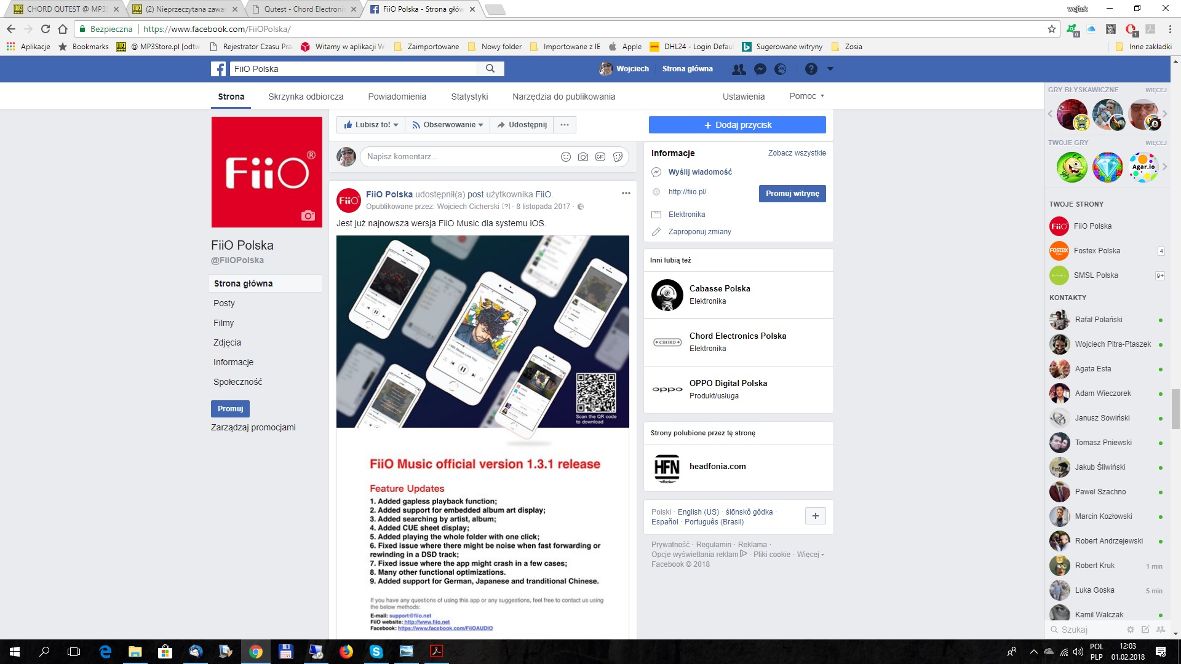
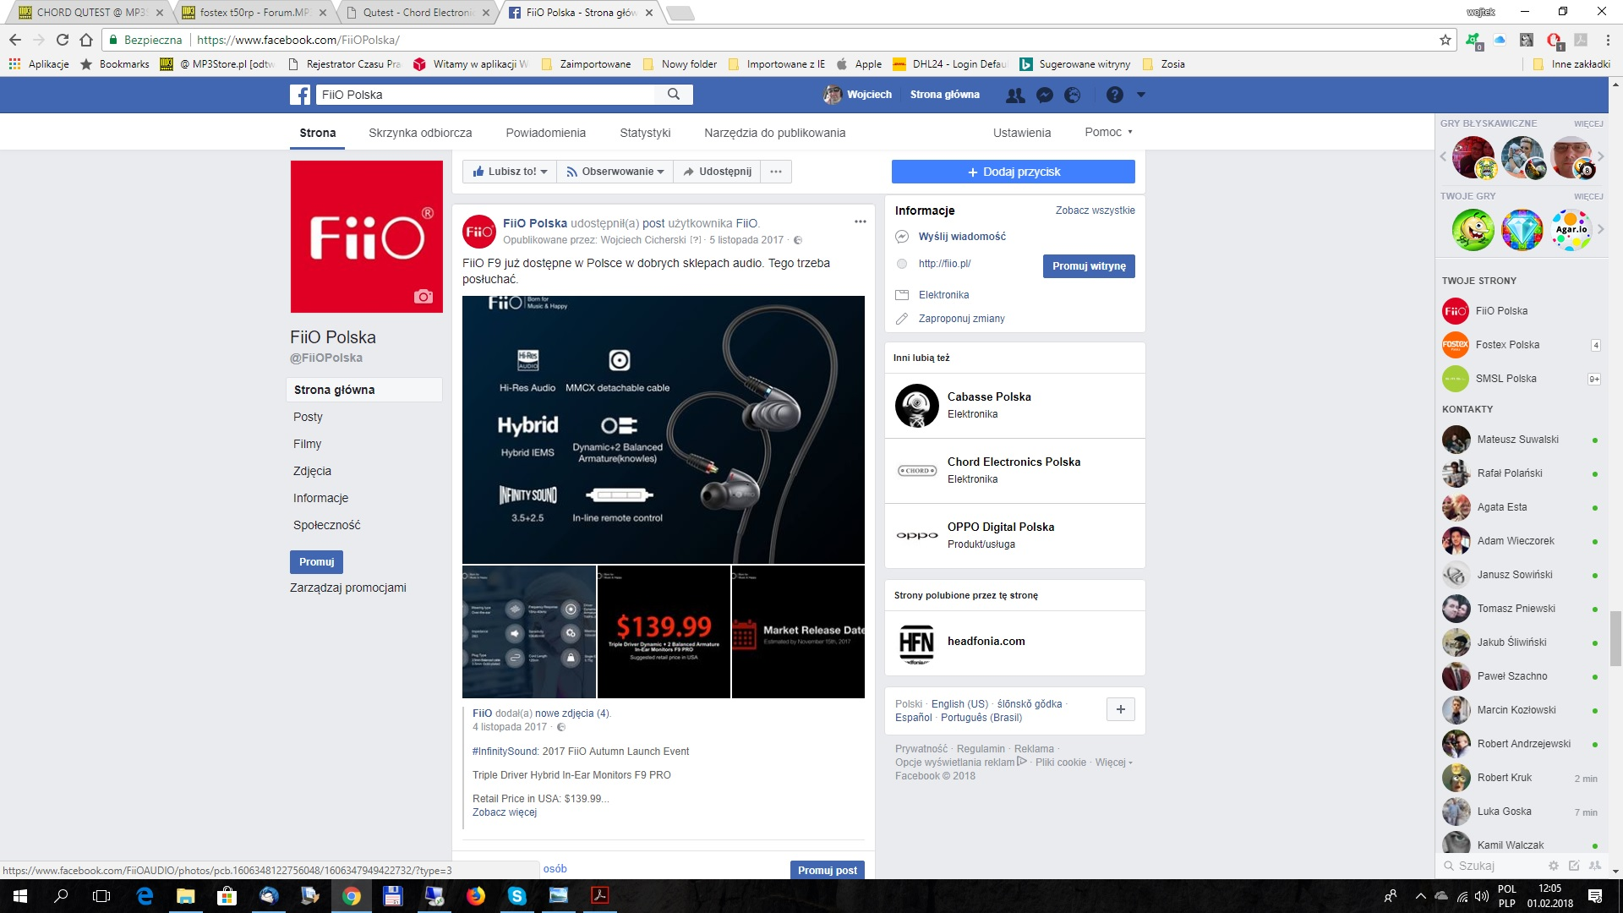
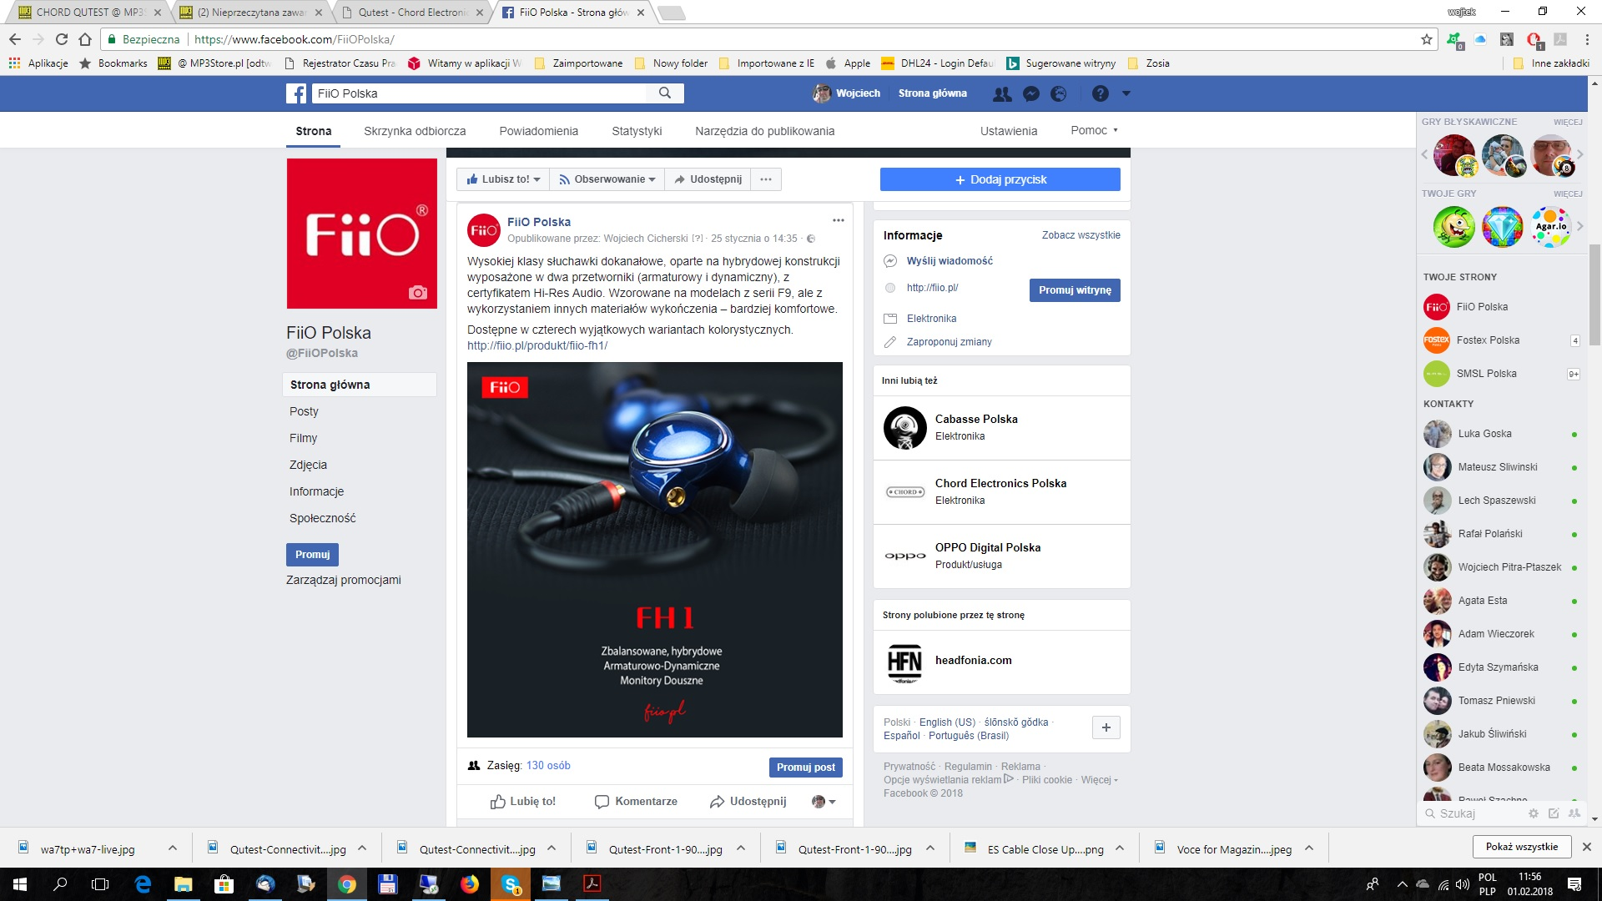
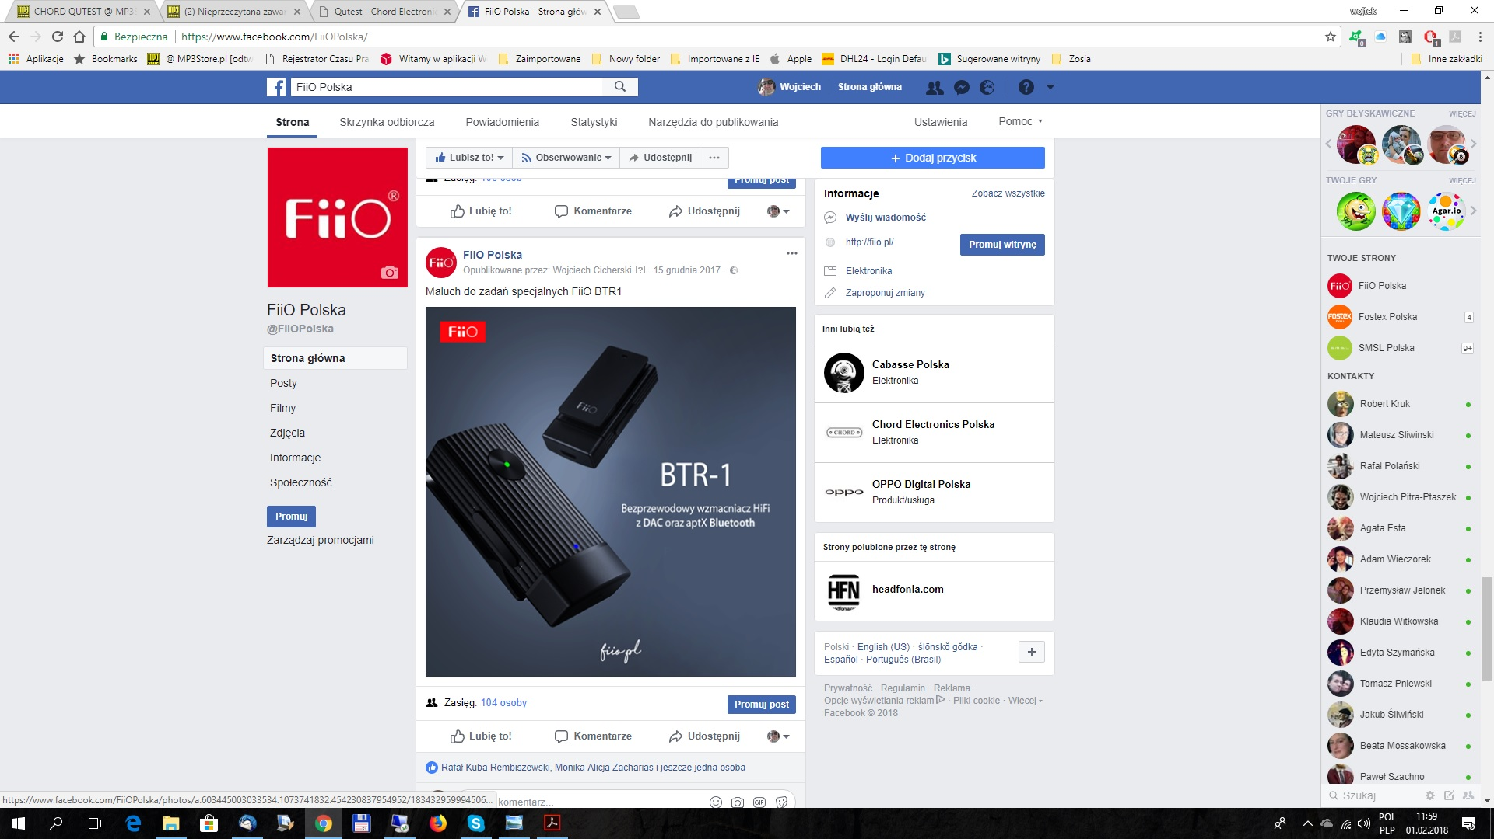
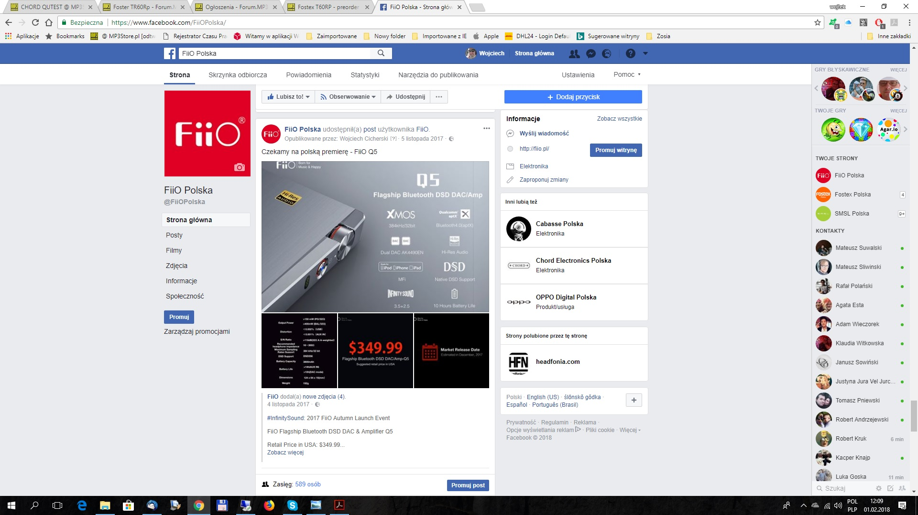
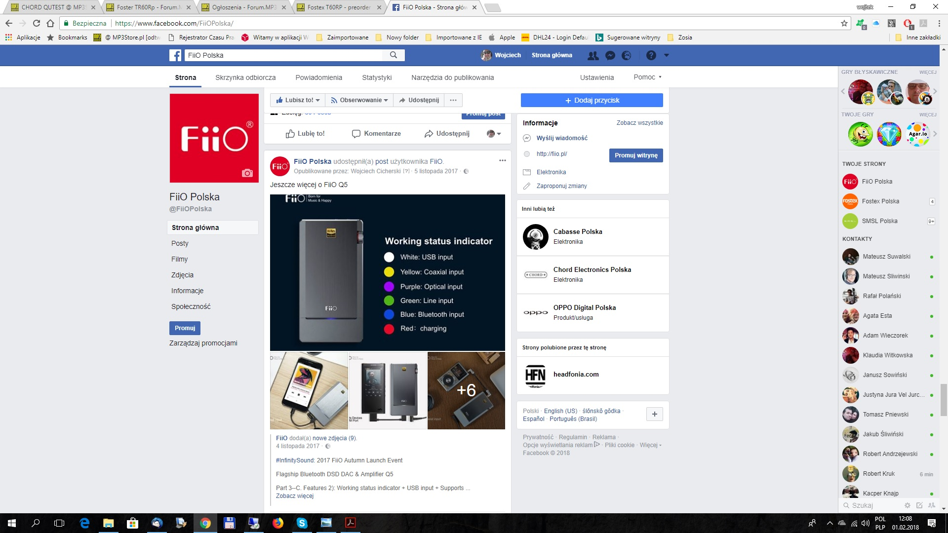
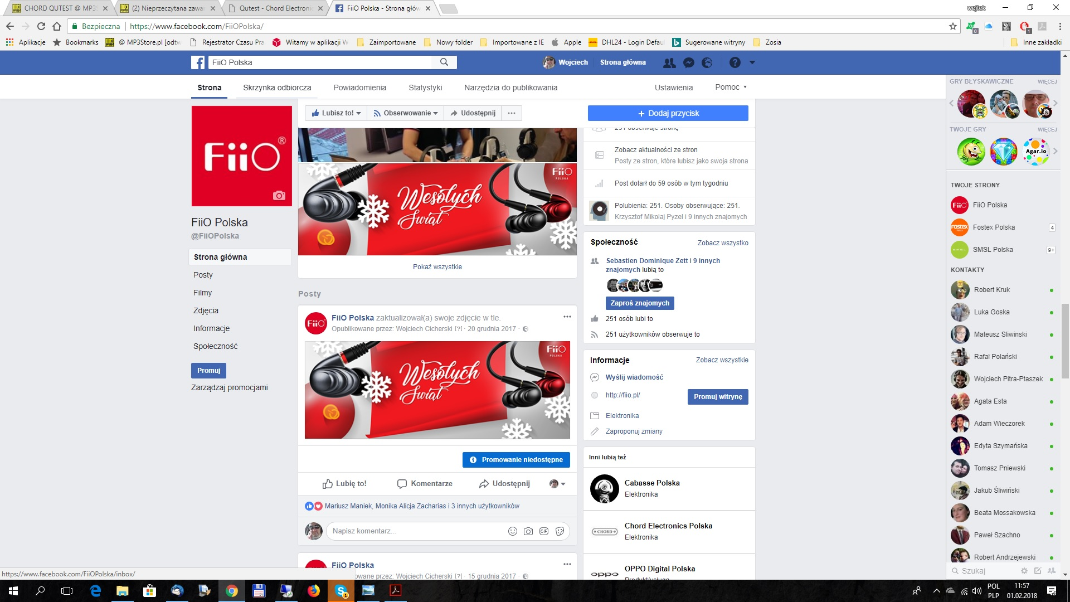
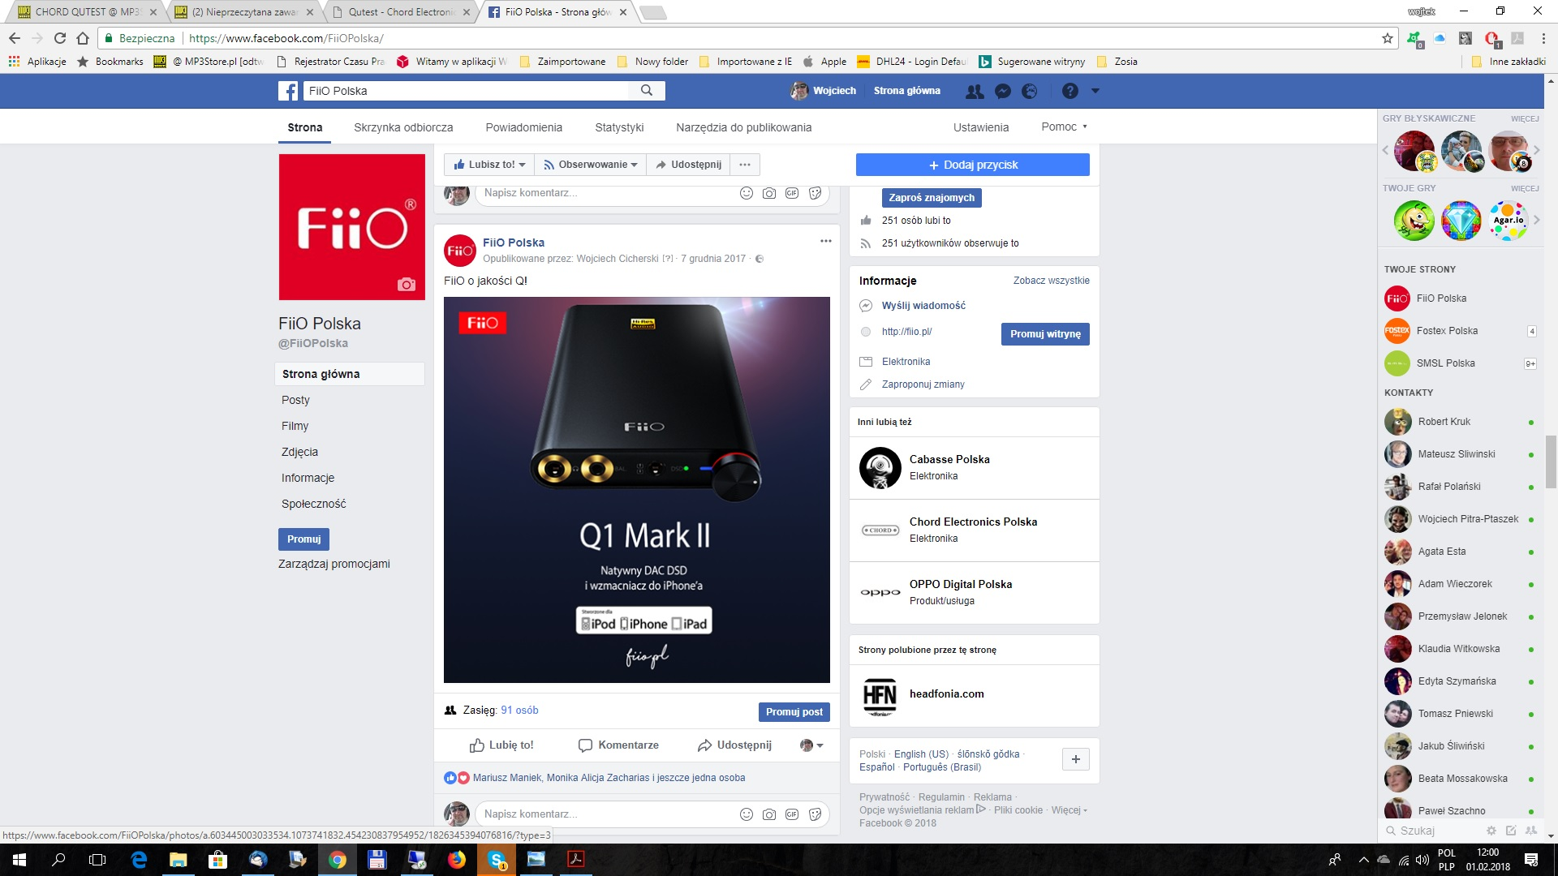
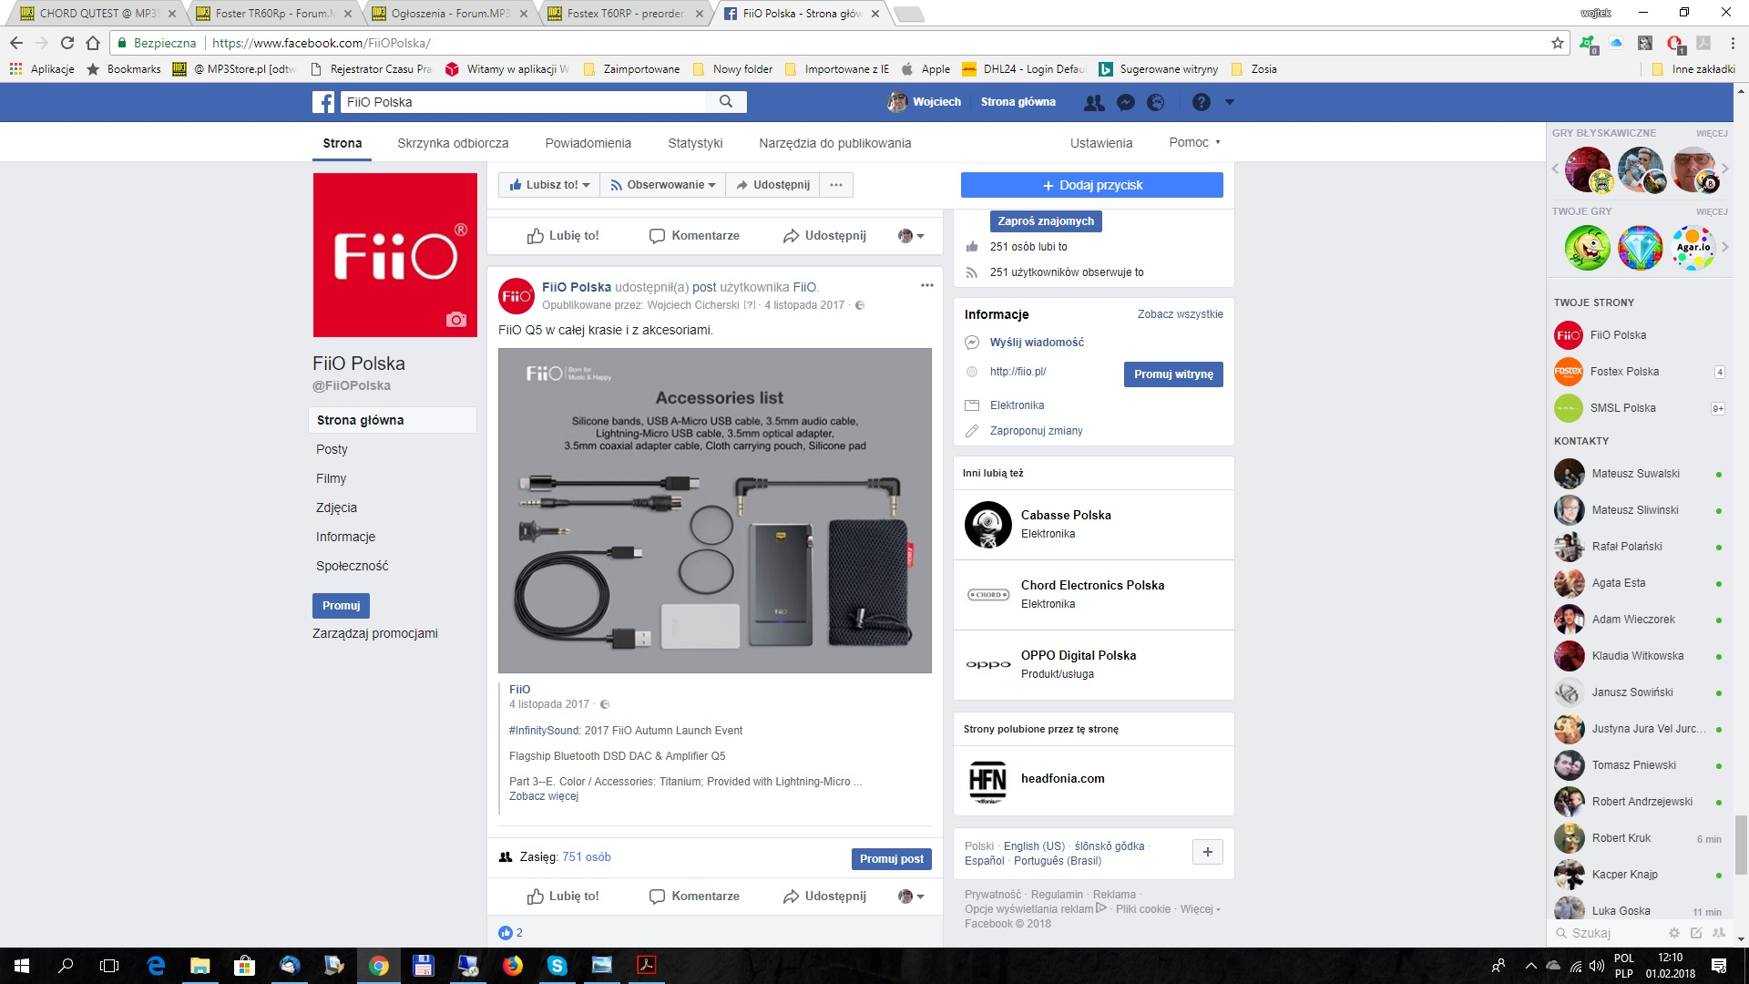
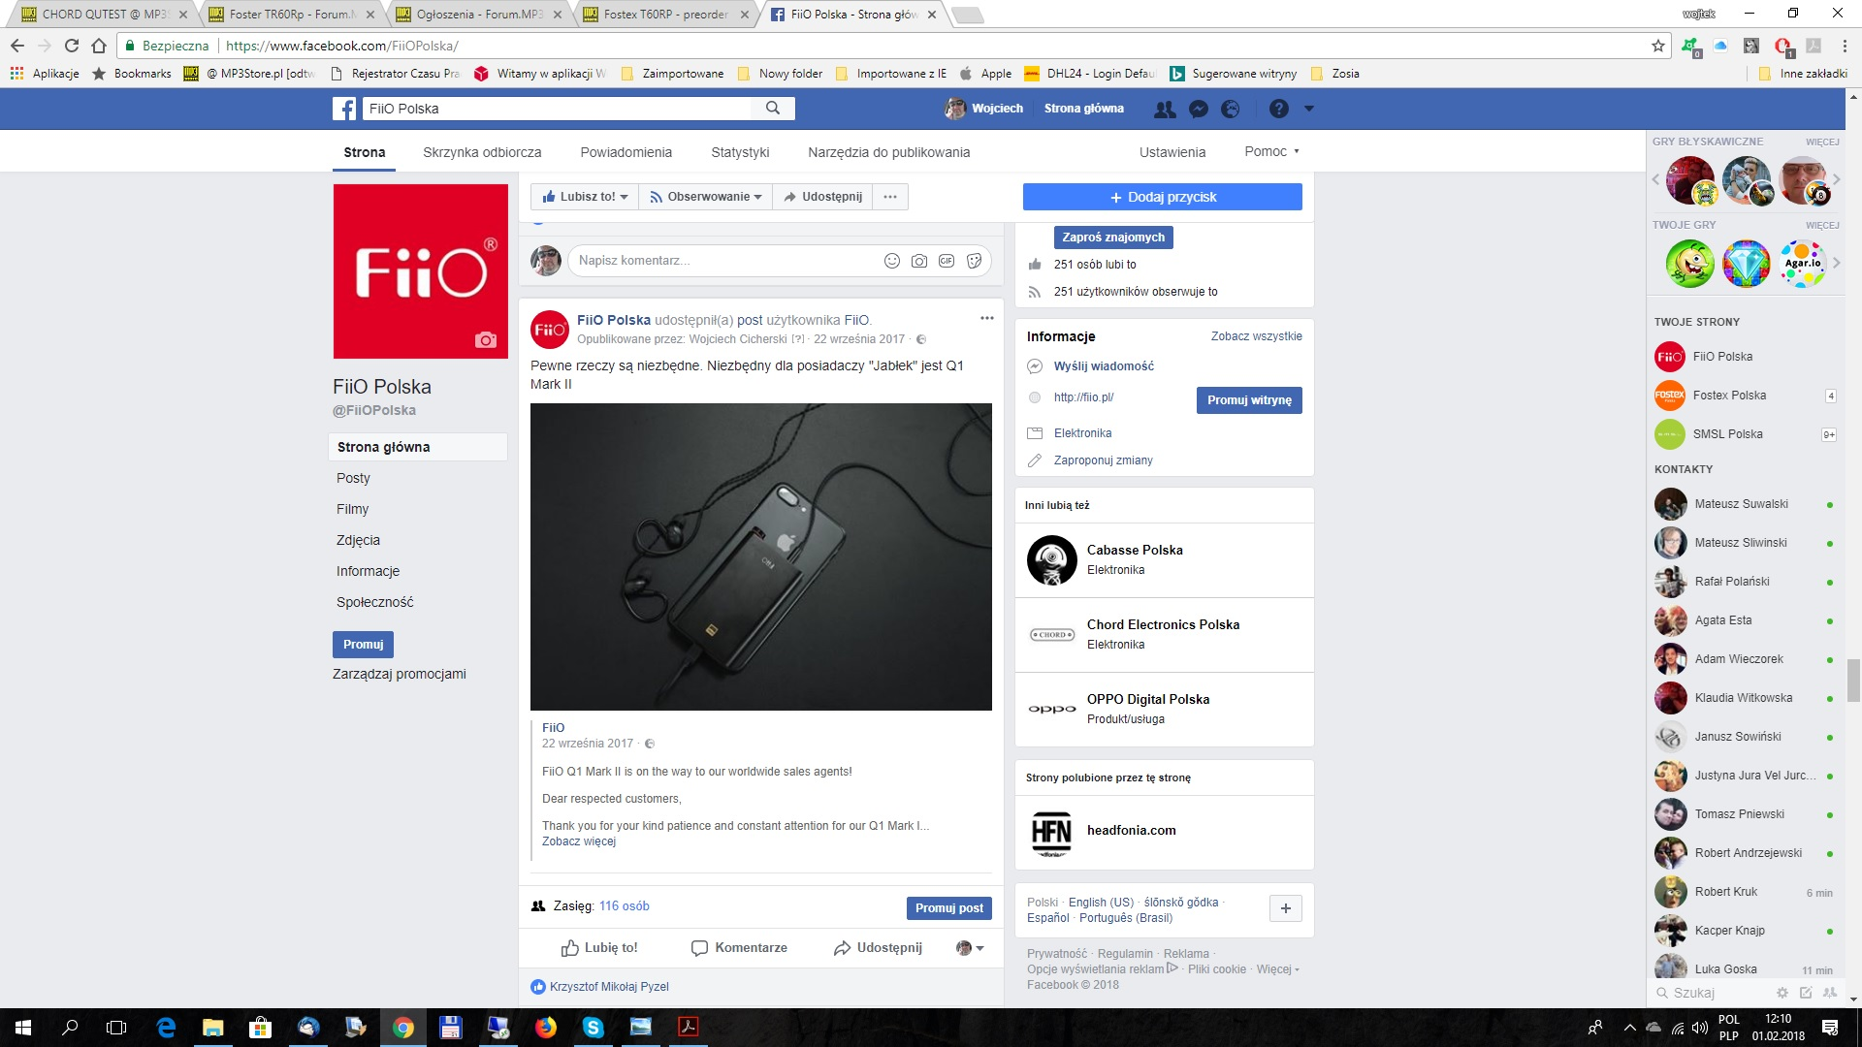
Facebook Update

Slide 5
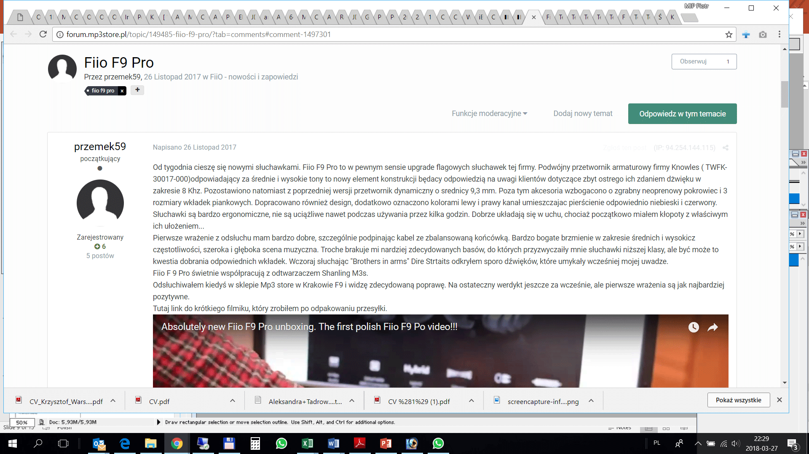
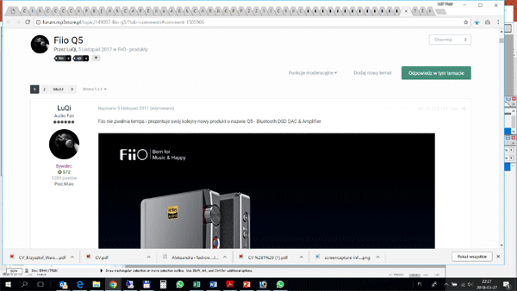
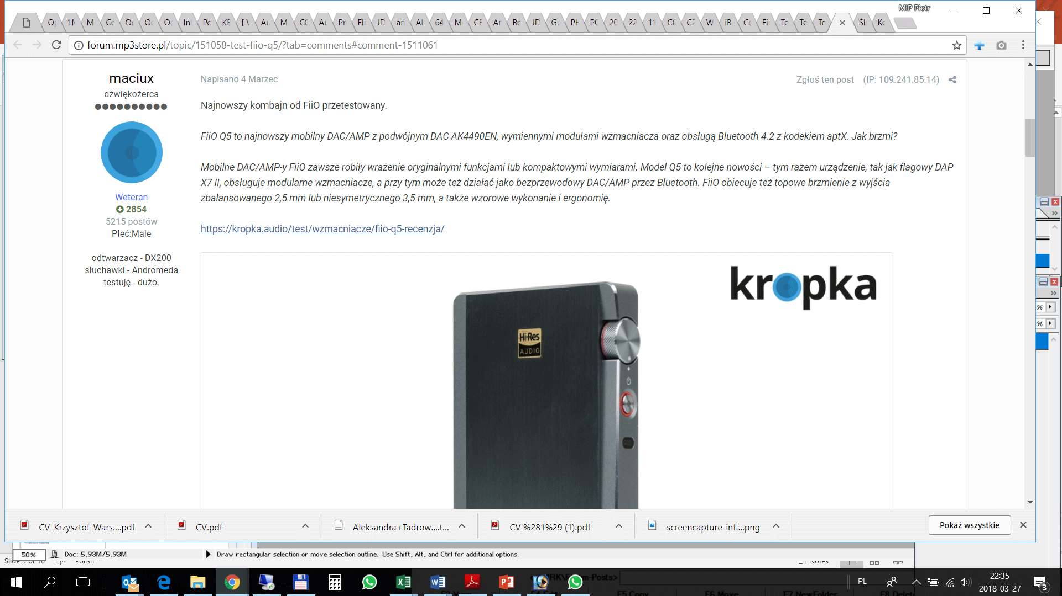
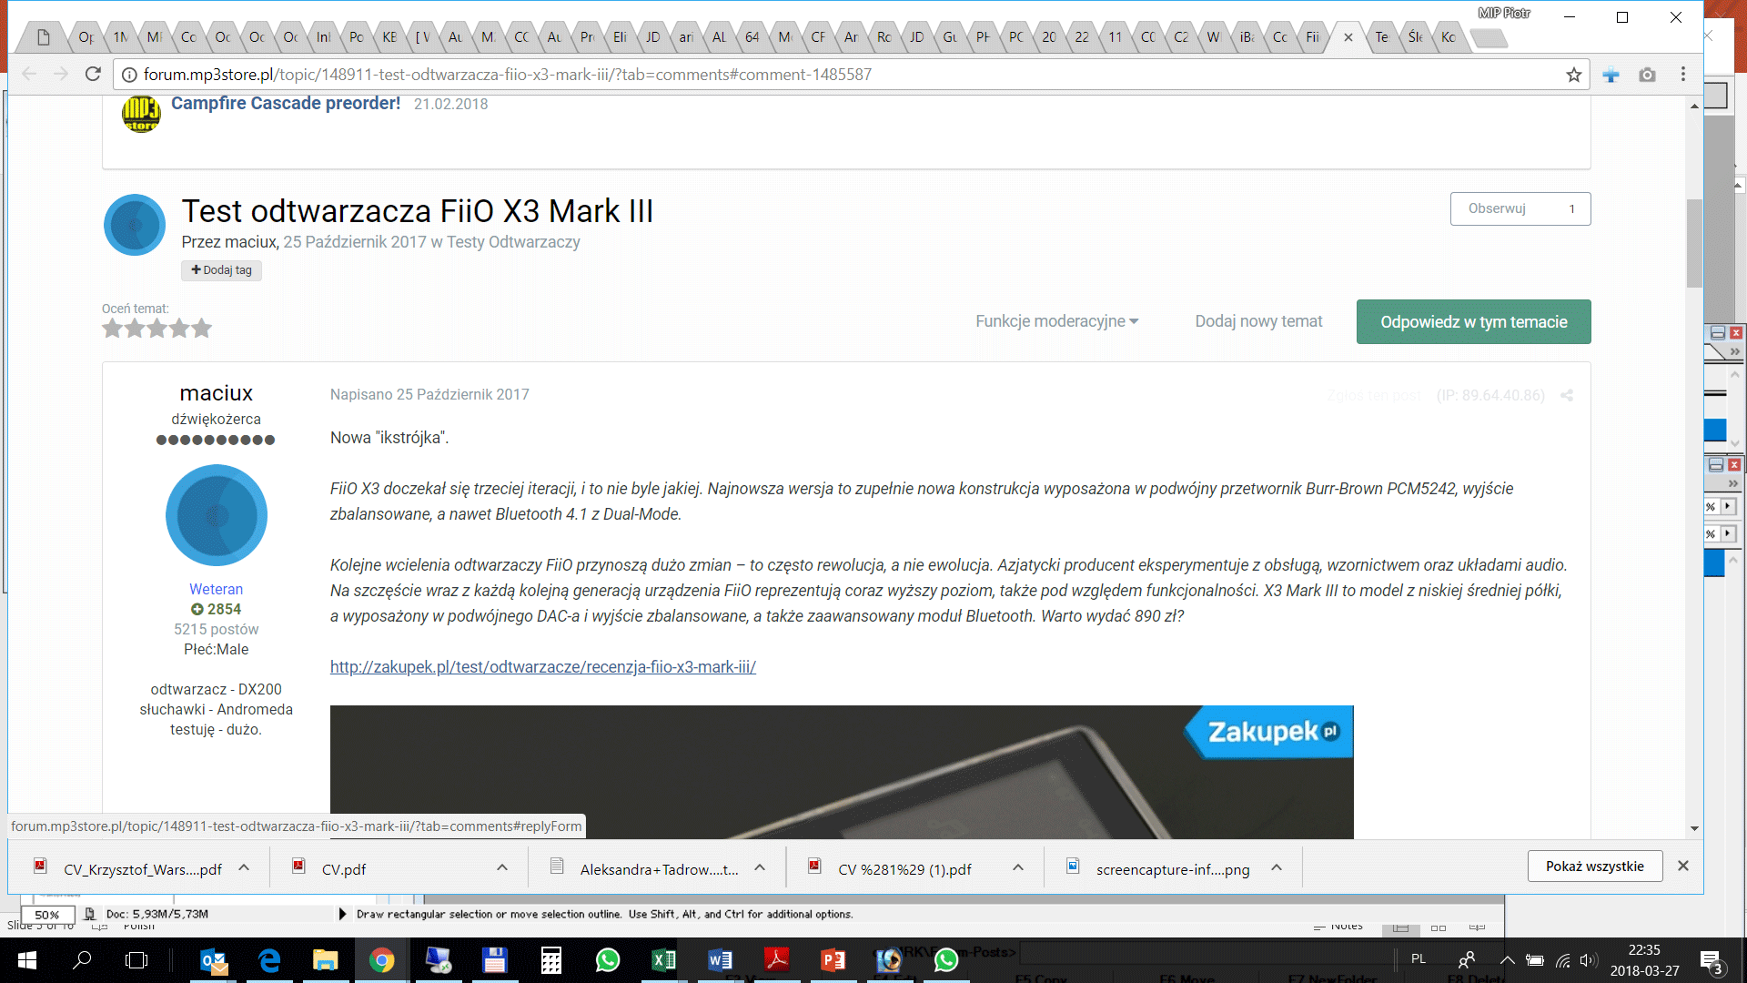
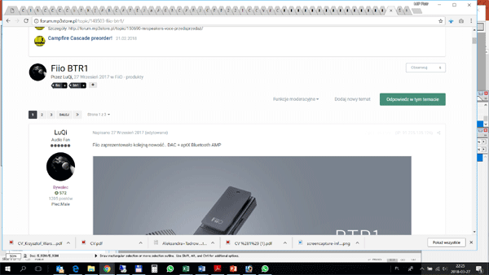
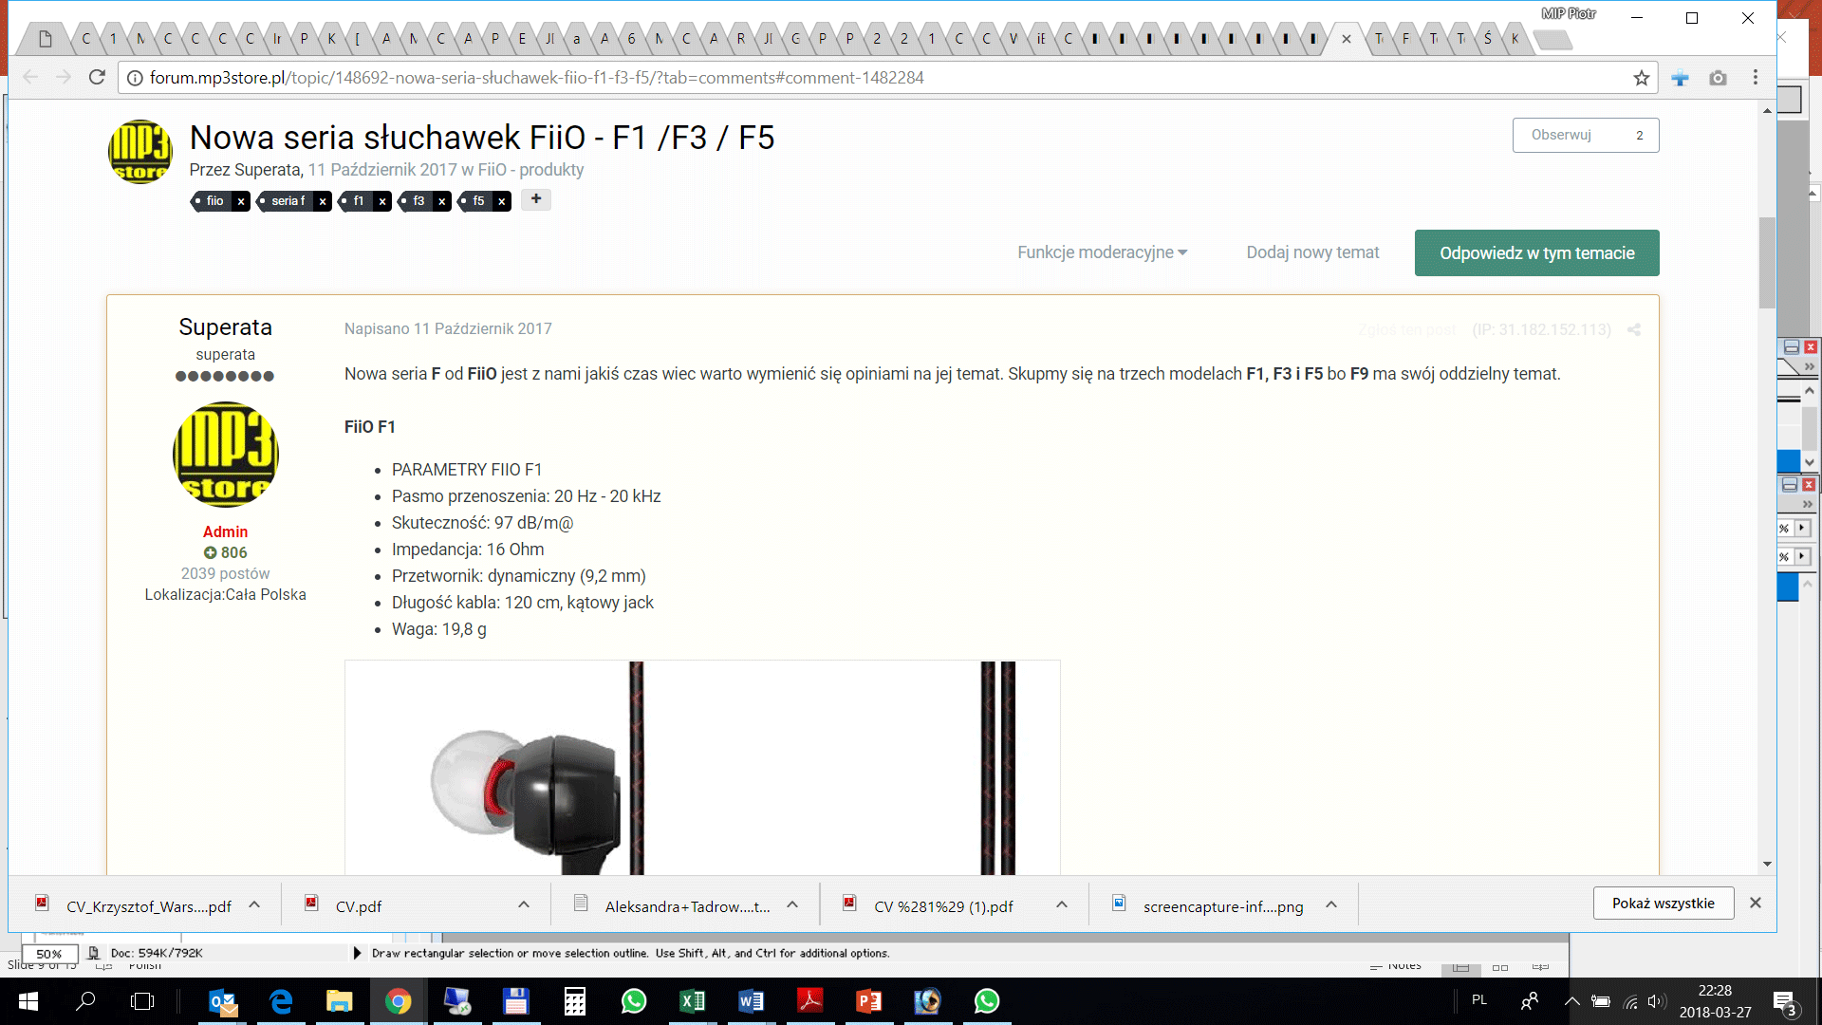
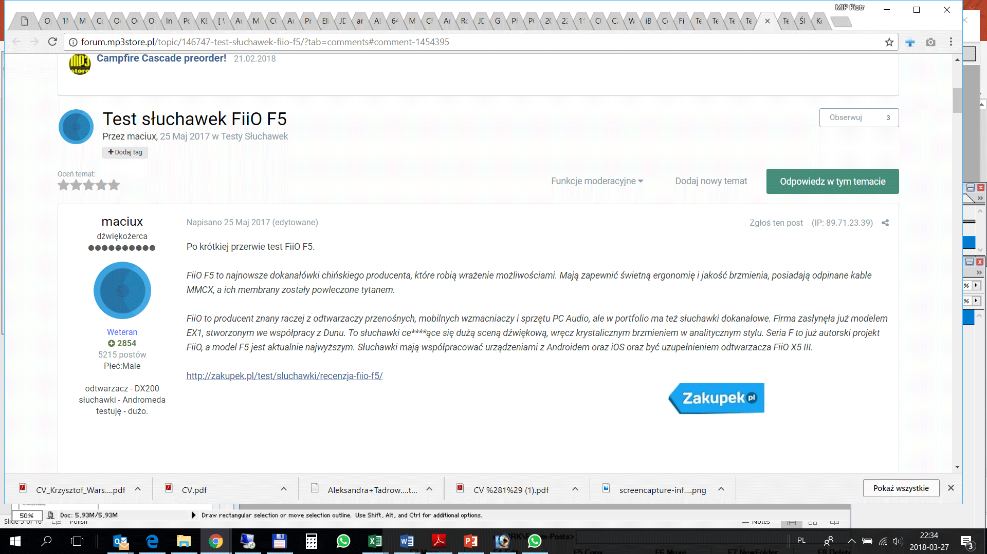
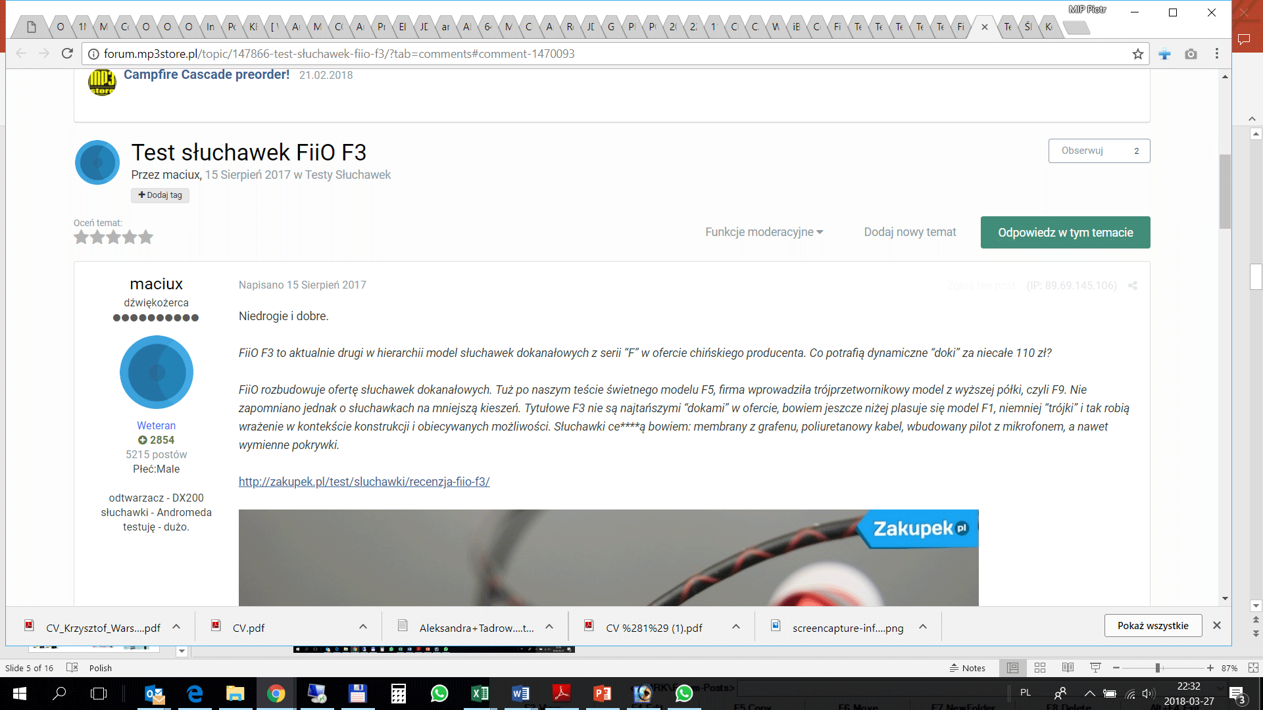
Audio Community threads about new models + published reviews from friendly portals

Slide 6
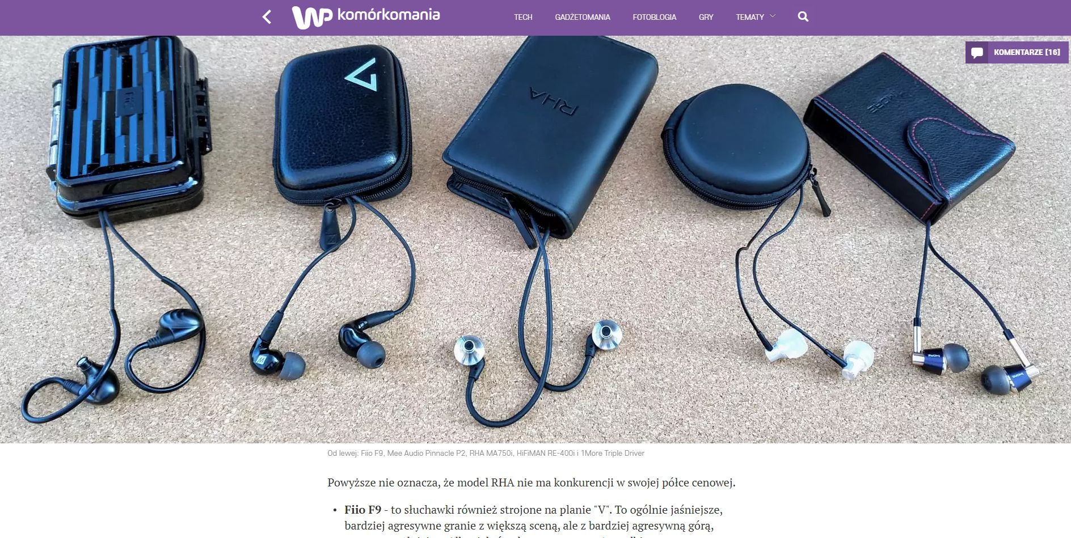
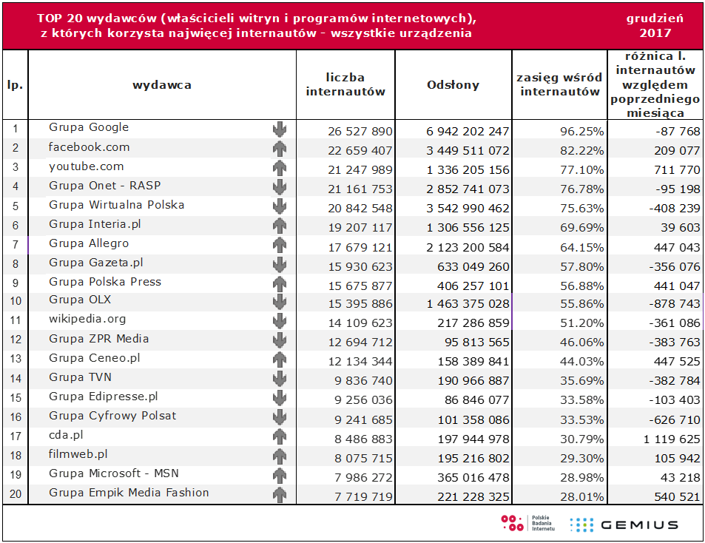
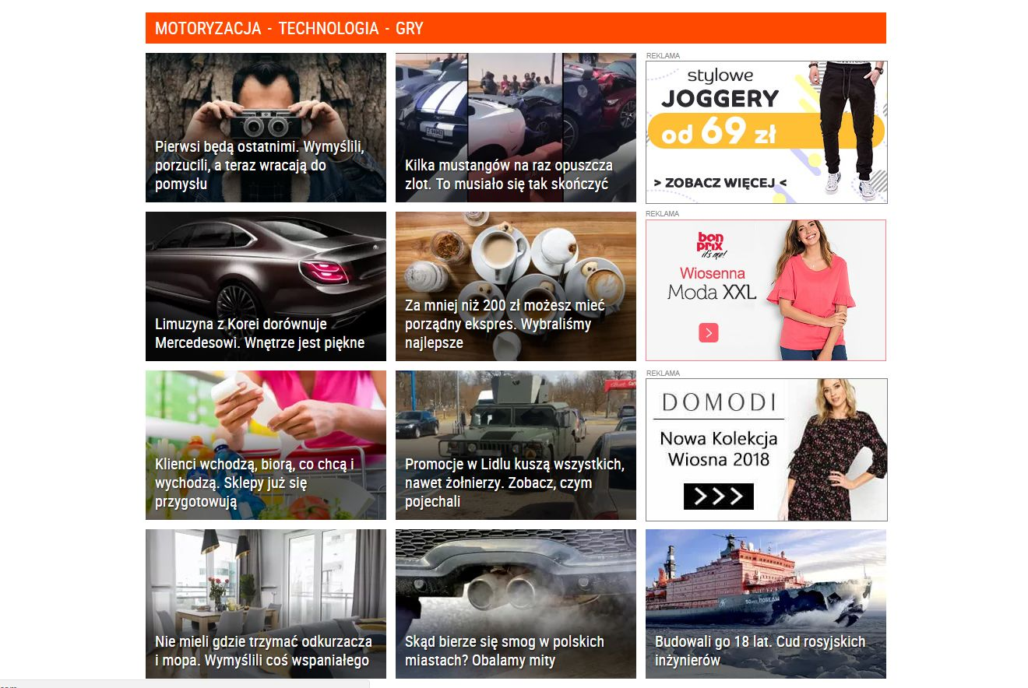
FiiO Testing
In middle of April we expect big test of earphones for Smartphones. It will be pubblished on very well know portal dedicated to Smartphones (komoromania.pl). About 2 000 000 visitors. It is owned but one of the biggest news portal in Poland - wp.pl (Wirtualna Polska – 21 000 000 internauts , 3 500 000 000views). They will promote also this test in hi-tec section. Normally it is very expensive , we cant afford to pay normally. We have a guy there but we also give some products for contests and offering technical help.All FiiO earphone will get recommendation. Also there will be individual test for each earphones which is very good for us as they have lots of views.

Slide 7
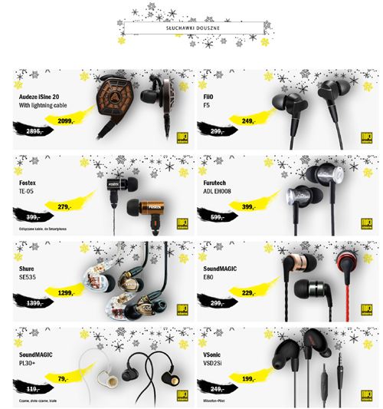
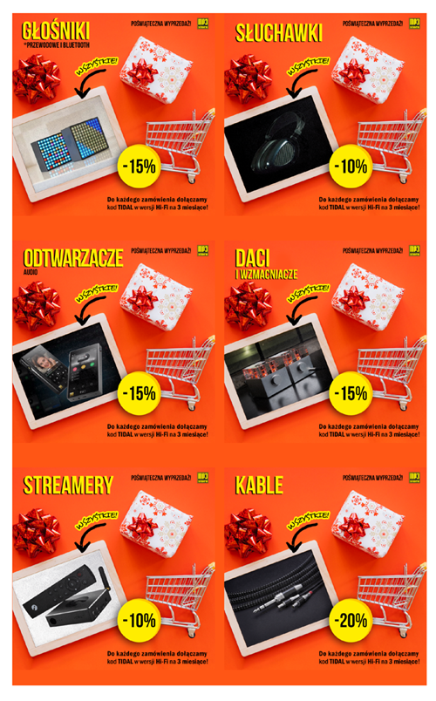
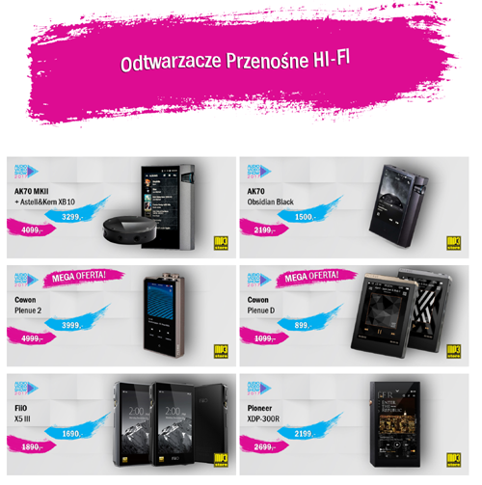
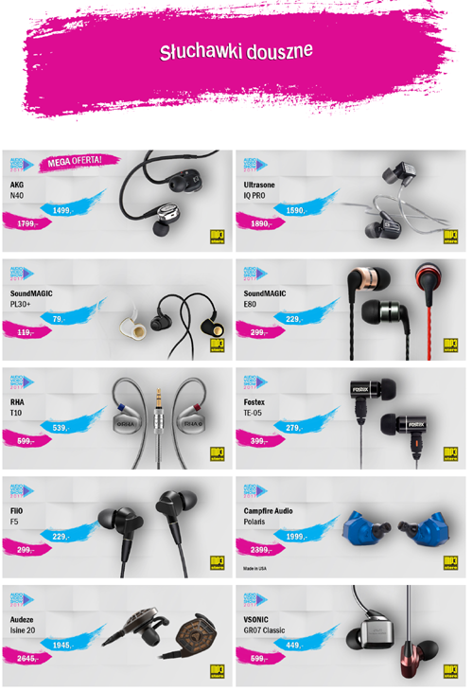
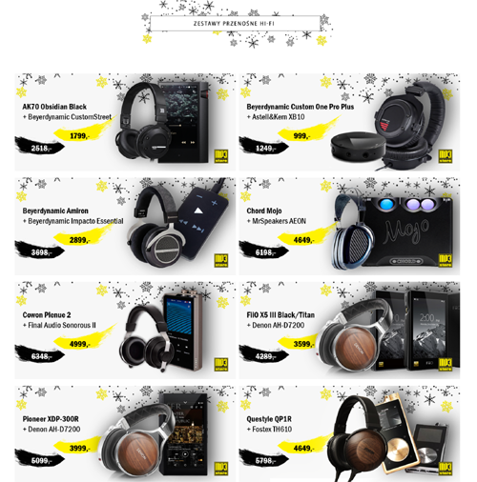
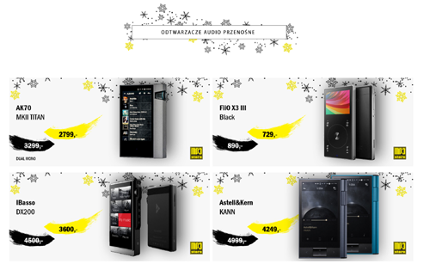
Occasional Promotional Activities
Audio Exhibition Promotion
Xmas Promotion
New Year Promotion
Winter Promotion

Slide 8
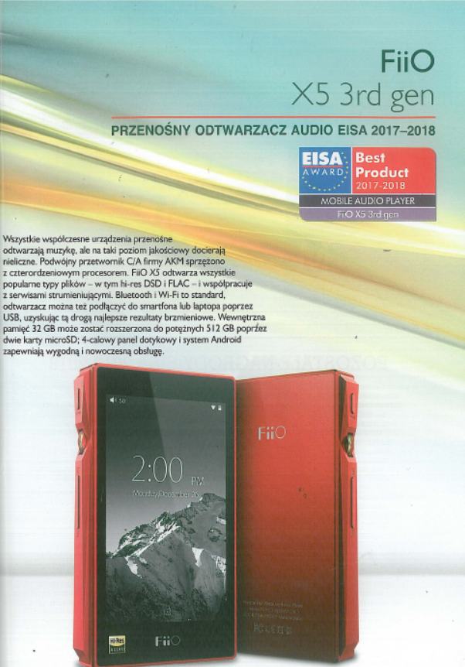
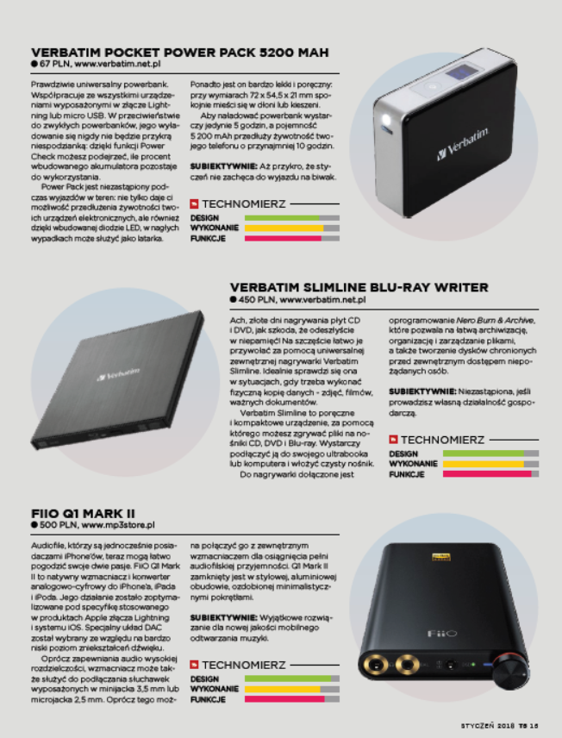
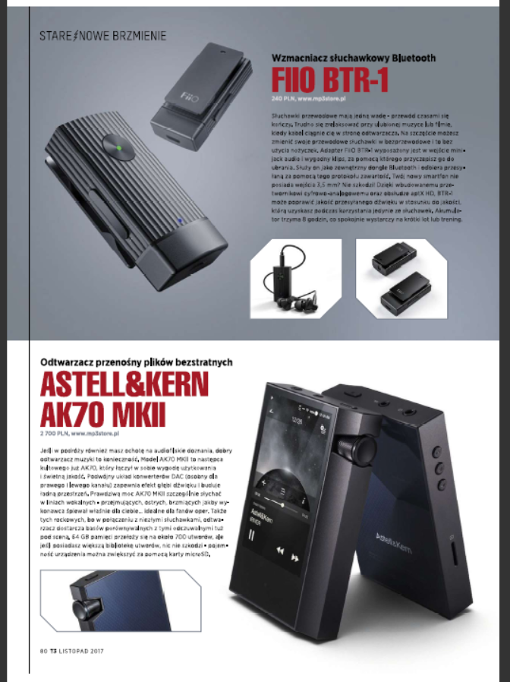
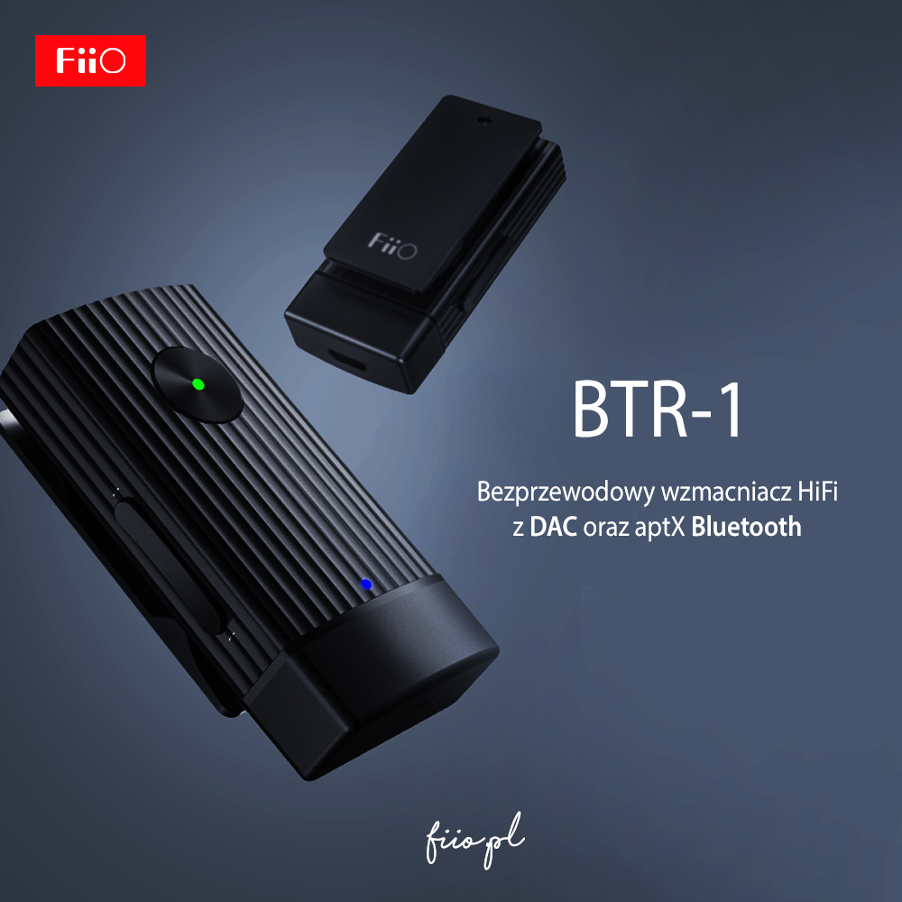
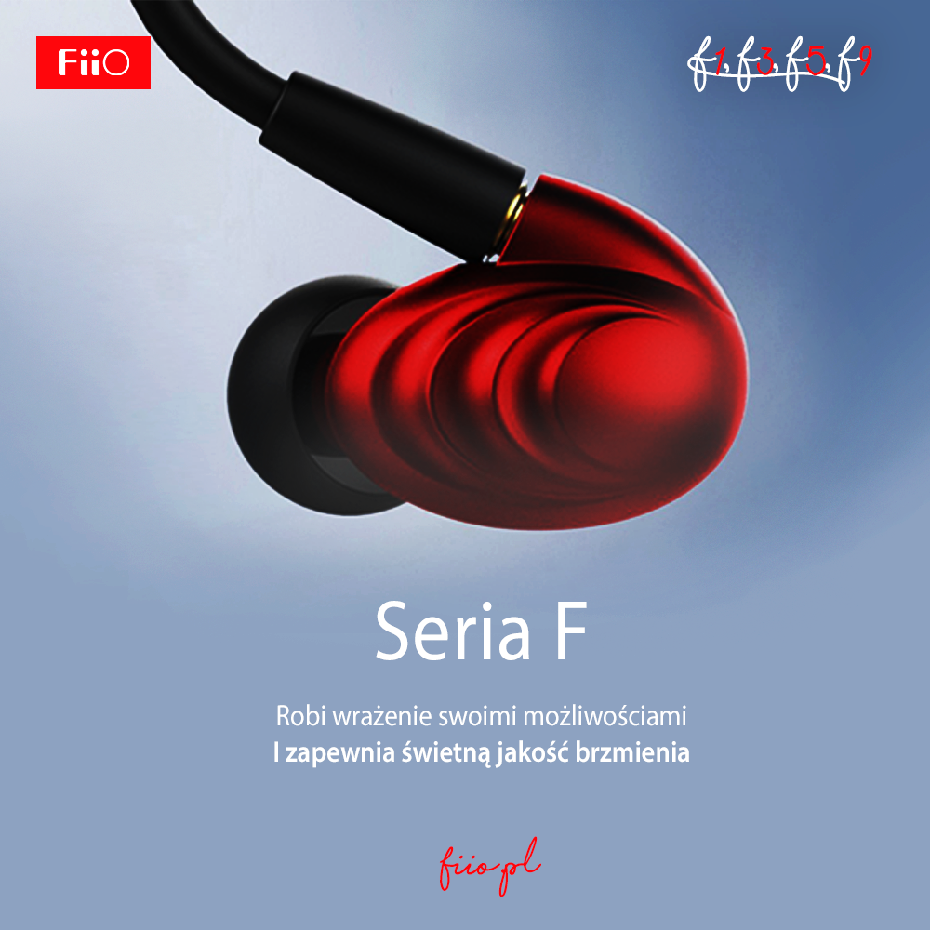
Some Adverts & Product Placement

Slide 9
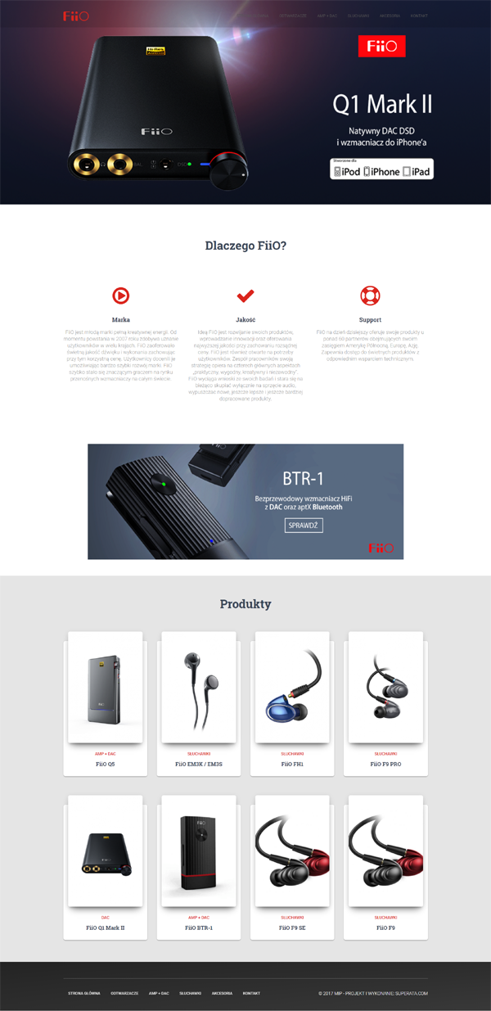
Polish Webside Update

Slide 10
Ongoing process of products manual translation for new models and other fiio products still in sales

Slide 11
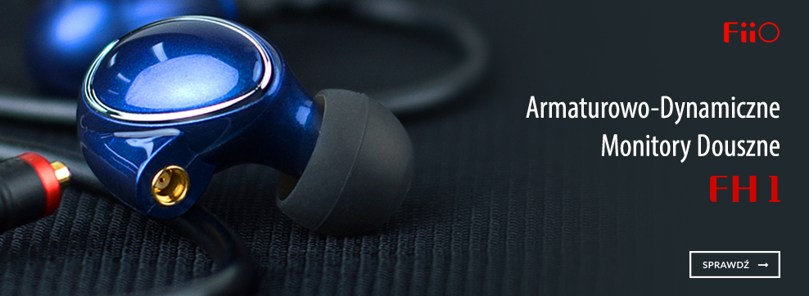
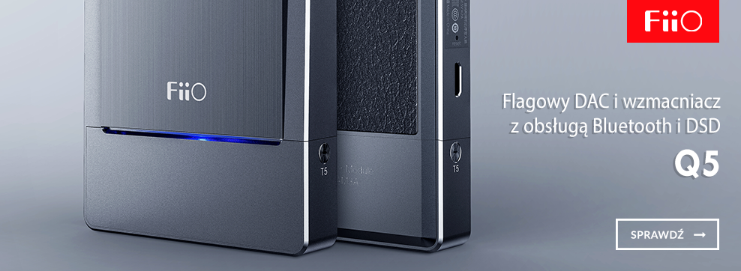
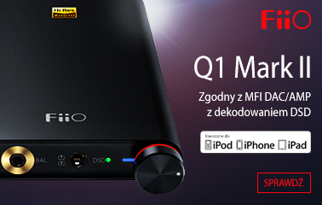
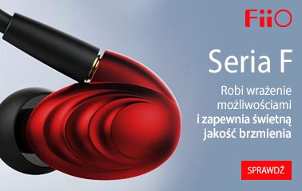
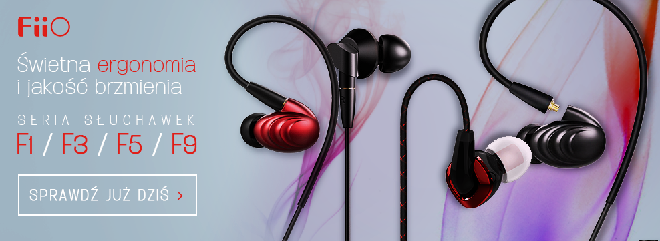
Banners for internet promotion

Slide 12
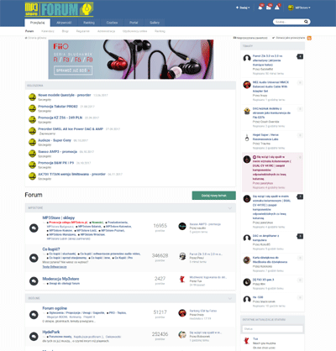
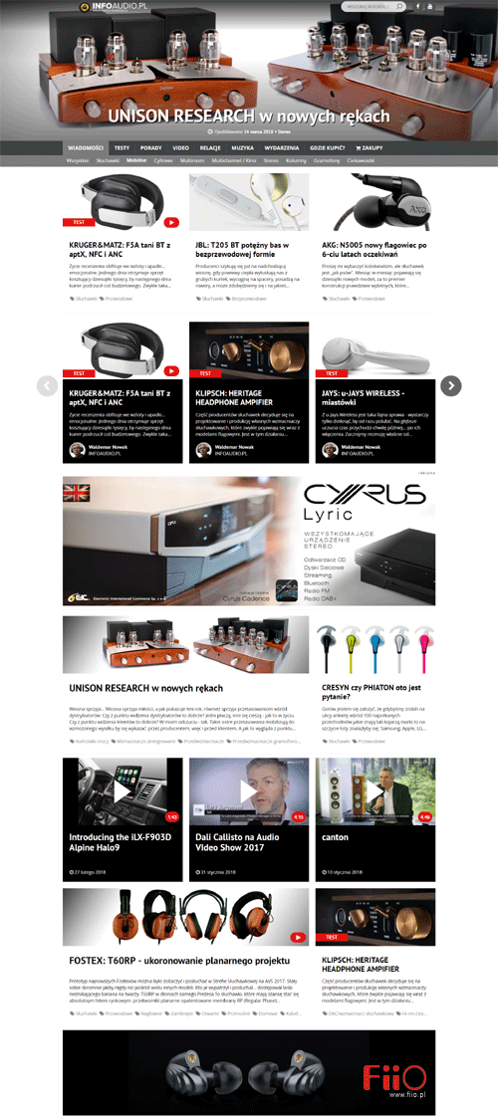
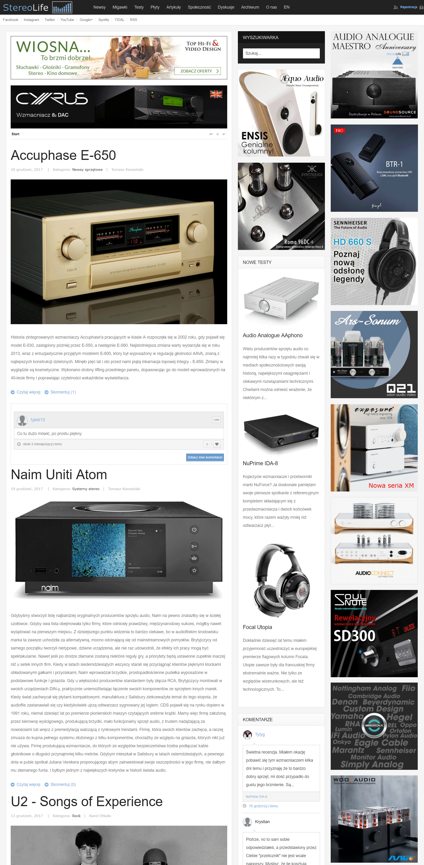
Example of Banners exposure

Slide 13
Brand Awareness in Big Retails
X-KOM – Several offline stores – it/electronics (earphones, soon amp/dacs)
Euro RTV-AGD – big electronic retail,c. 150 offline stores in big cities (players, soon the rest of the offer)
Empik – retail similar to Virgin - c. 150 offline stores (all models)
AB – Big IT distrbutor (all models)

Slide 14
Brand Awareness in Big Retails
Media Expert – big electrnics retail, c. 300 offline stores in middle and small cities (uploading now)
Carrefour – big FMCG/Electronics retail (all models)
Morele.net- famous internet e-tailer with offline pick-up points
Emag.pl – another important e-tailer. Now bought by Romanian company

Slide 15
Example of on store marketing

